Slide 1
HR MANAGEMENT SYSTEM

Slide 2

Team Members
161611 : Manish Rahangdale
161585 : Viraj Dere
161289 : Mohammed Allauddin Shaik
161700 : Vinay Samudrala
161288 : Jitendra Sai Pandava
161698 : Apoorva Nath
161599 : Prudhviraj Cirikonda

Slide 3
Project Details
This project is aimed at developing a Windows application - HR Management System (HRMS) to manage Employee information.
Technology used:
Presentation Layer
WPF 4.5
Business Layer
Business Logic Components and Services :-
C# 5.0
Database Layer
Databases:-
SQL Server 2012

Slide 4
SCOPE
This application will help HR department to manage their Employee information. This will enable HR department employees to view Add, Update, Delete, Search and List Employees of the organization. An HR Clerk or Manager can register themselves with the application and perform the above-mentioned tasks.

Slide 5
Role of HR Clerk
Add, Update, Delete, Search and List of Employee
Add, Update, Delete, Search and List of Projects
Add, Update, Delete, Search and List of Skills
Add, Update, Delete, Search and List of Categories

Slide 6
Role of Admin
Create and manage Users, Roles and assign Roles to Users.
Create and manage CivilStatus, Level and Speciality.

Slide 7
Design guidelines
All the exceptions/errors to be captured and user-friendly message to be displayed on the Windows.
Use ADO.NET for Data access layer. Make use of stored procedures. All the database interaction would be performed using Data Access Component. Most common methods in Data Access Component would be :
Create Connection to the Database
Create Command Object
Set Command Type to Stored Procedure
Create and Populate Parameters
Execute the Command
Close the Connection

Slide 8
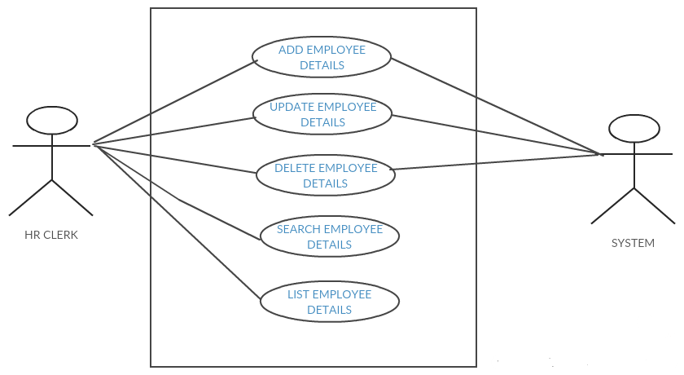
Use Case Diagram

Slide 9
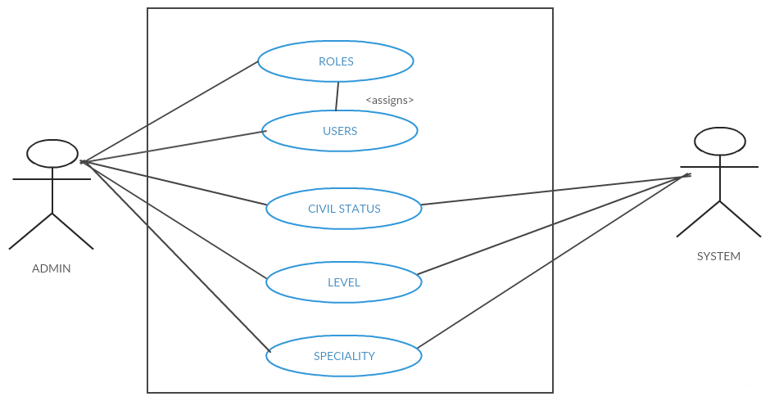
Use Case Diagram

Slide 10
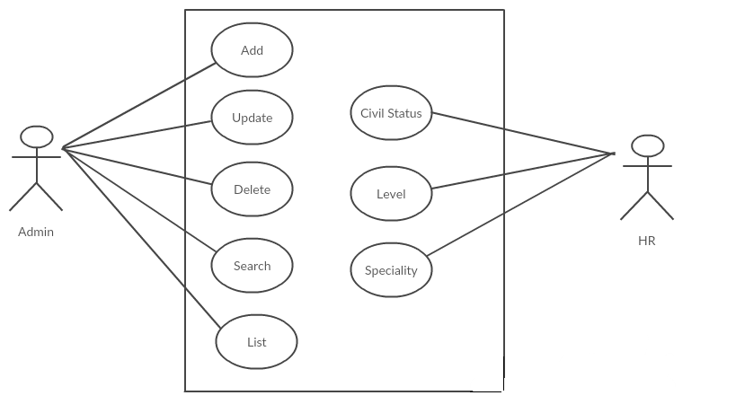
Use Case Diagram

Slide 11
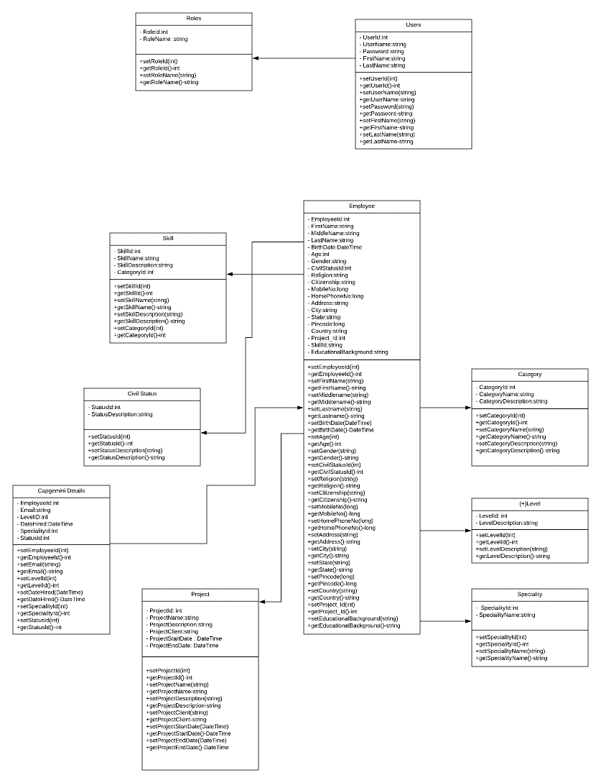
Class Diagram

Slide 12
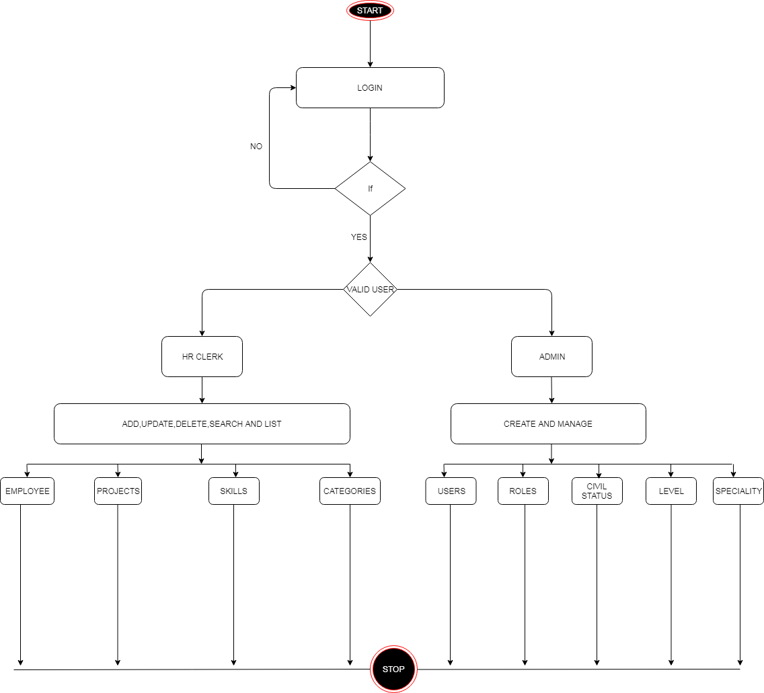
Sequence/Activity Diagram

Slide 13
Screen shots

Slide 14
Screen shots

Slide 15
Future Enhancements
It will help the HR for assigning the projects to the employee according to their skills
and level.
It will help the admin to assign the roles to the users based on specialty of the user.
It will provide the proper management of employee data based on their levels and roles.

Slide 16

Thanks

